Slide 1
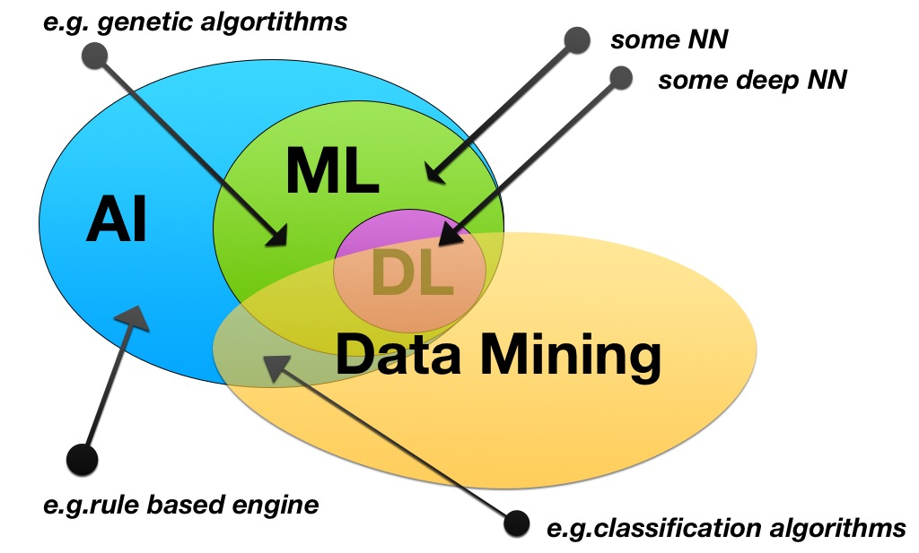
AI
ML
AI vs. ML vs. DL
Three terms beginners mix up constantly — and how they actually nest inside one another.
DL

Slide 2
01 · THE HARD QUESTION
What is intelligence, really?
Before we can build it artificially, it's worth admitting how little consensus there is.
We usually say humans are more “intelligent” than other species. But intelligence itself resists a clean definition — it isn't one thing, it's a bundle of different capabilities working together.
THE UNCOMFORTABLE TRUTH
Nobody fully agrees on what intelligence is. We can't precisely define creativity or emotion in computable terms — so “artificial intelligence” was never aiming at one crisp target.
Most real AI progress has quietly narrowed its ambitions to specific, testable capabilities (reasoning, prediction, pattern recognition) rather than a full general intelligence matching our own.
Reasoning & logic
Problem solving
Creativity & imagination
Emotional intelligence
2

Slide 3
02 · THE BIG PICTURE
AI, ML, and DL are nested — not separate
Artificial
Intelligence
Artificial Intelligence
The broad goal: build machines that behave intelligently, whatever technique gets you there.
Machine
Learning
Machine Learning
DL
One approach to AI: instead of hand-coded rules, the system finds patterns in data on its own.
Deep Learning
A specific approach within ML, using layered neural networks that also learn their own features.
3

Slide 4
03 · A BRIEF HISTORY
Before ML: the Symbolic AI era
The idea of intelligent machines goes back decades — long before data-driven learning took over.
HOW IT WORKED
WHERE IT WORKED — AND WHERE IT BROKE
Researchers sat down with human experts, extracted their knowledge as explicit rules, and encoded that “knowledge base” directly into a program. This approach is often called Symbolic AI or expert systems.
Worked well for: narrow, logic-heavy problems with clear rules — like game strategy or structured diagnosis.
Broke down on: perception problems — recognizing an image, understanding speech. Nobody could write down “all the rules” for what makes a photo contain a dog. Breeds vary too much in size, color, and shape to enumerate by hand.
SIGNATURE EXAMPLE
Chess-playing programs — an expert's strategic knowledge, converted into if-then rules a machine could follow.
4

Slide 5
04 · THE SHIFT
Enter Machine Learning
DEFINITION
Machine Learning is a branch of computer science that uses statistical techniques to find patterns in data automatically — rather than relying on explicitly hand-coded rules.
Worked example: classifying dog breeds
THE HUMAN PARALLEL
Symbolic AI would try to hand-write rules per breed — impossible given the variation. With machine learning, you instead show the system thousands of labeled photos (“this is a dog,” “this is not”) and let it work out the underlying pattern itself. That pattern-finding process is what we call learning.
This mirrors how children learn animals — shown examples and gently corrected, not handed a rulebook of features to check.
5

Slide 6
05 · COMPARISON
Symbolic AI vs. Machine Learning
Symbolic AI
Machine Learning
Where rules come from
Written by hand, from expert knowledge
Learned automatically from data
Best suited for
Narrow, logic-heavy problems
Perception & pattern-heavy problems
Adding a new case
Requires rewriting rules
Requires more training data
Classic example
Chess-playing programs
Dog breed image classifier
6

Slide 7
06 · ONE LEVEL DEEPER
So why do we need deep learning at all?
If ML already learns from data, what's left for DL to add?
The process actually looks the same
KEEP THIS QUESTION IN MIND
Feed the algorithm data → train it → reduce its error over time → deploy it. That loop is identical for both classical ML and deep learning — which is part of why the distinction confuses people.
If the training loop is the same, and the biology is only loosely inspired — what is the actual, practical difference between classical ML and deep learning?
That's exactly what the next slide answers.
Where the name comes from
Deep learning's core unit is the perceptron, loosely inspired by a biological neuron. But this is loose inspiration, not simulation — a network of perceptrons doesn't work the way an actual brain does. “Deep” refers to stacking many layers of these units on top of each other.
7

Slide 8
07 · THE REAL DIFFERENCE
Feature engineering: who finds the signal?
Machine Learning — you define the features
Deep Learning — the network finds its own
For a placement-prediction example, you decide upfront which signals matter — then hand them to the model:
Example: recognizing a handwritten digit. Each layer builds on the last, forming increasingly abstract representations — automatically, with no manual feature list:
Number of certifications
Layer 1 → detects raw edges
Internship experience (%)
Layer 2 → groups edges into strokes/parts
Communication skills score
Final layer → identifies the digit
…every other feature you think to add
More layers generally means richer, more useful representations — up to a point.
If you miss a feature that actually mattered, the model never sees it.
8

Slide 9
08 · THE TRADE-OFF
Why deep learning is hungrier for data
PERFORMANCE VS. DATA VOLUME
WHAT THAT MEANS IN PRACTICE
performance ↑
Classical ML models tend to plateau — past a certain point, more data barely improves them.
Deep learning keeps improving as data grows, but it needs a large volume before it starts to shine, plus real compute power (GPUs) to train.
Small dataset, tight budget, tabular data? Classical ML is usually the safer, cheaper choice.
Deep Learning
Classical ML
data volume →
9

Slide 10
09 · DECISION GUIDE
When to reach for which
Deep Learning shines
Classical ML shines
Unstructured data: images, audio, raw text
Structured, tabular data (banking, insurance)
Very large datasets available
Small or moderate dataset size
GPU / compute budget available
Limited compute budget
Feature list isn't obvious in advance
Domain experts can define good features
10

Slide 11
SUMMARY
Key takeaways
1
It's nested, not separate
2
Symbolic AI came first
AI is the broad goal; ML is one approach to it; DL is one approach within ML.
Hand-written rules worked for narrow, logical problems — but not for perception.
3
ML learns the rules
4
DL learns the features too
Show it labeled data, and it finds the pattern connecting input to output itself.
Layers build increasingly abstract representations automatically, with no manual feature list.
5
DL trades data for accuracy
6
Pick based on your data
It needs far more data and compute than classical ML, but keeps improving as both grow.
Unstructured + large + high compute → DL. Tabular + small + limited compute → classical ML.
11

